Slide 1

Presentation of
POS system
52RETAIL from

Slide 2

Agenda
Stability and reliability
Training of new employees
Scalability and modularity
Selection of modules
Chain management
Development and roll-out
Integrations
Omnichannel and optimization
Costs
52RETAIL customers
Video – overview of 52RETAIL Omnichannel
Notes:
You can delete topics not relevant to you or change the order of topics according to your priorities. Remember to change/delete slides in the presentation.

Slide 3
Stability and reliability
52RETAIL is a Point-of-Sales solution tested thoroughly and has been used by some of the largest retailers in Denmark for more than 30 years.
The combination of a stable solution and highly skilled support consultants ensures that the check out counter is always running.
The architecture is developed with stability of data transportation and transaction speed in mind.

Slide 4
Training of new employees
The POS solution can be configured to only show the features and functions needed by the staff.
  This means that time to onboard employees and error recording is minimized.
The screen design can be configured to be simple and intuitive for the staff.
Training can be conducted online using the employee’s till.

Slide 5
Scalability and modularity
The solution is scalable in functions and features but also in number of stores.
The solution is modular and let’s you start with a basic setup and then build on top with modules as they are needed.
The solution is adaptable to your existing infrastructure which allows you to only change parts where you decide to upgrade based on your needs.
Notes:
A good idea is to remind your audience that a selection of modules is available on the next slide.

Slide 6
Selection of modules
Loyalty and customer club integrated with your POS solution
Discount and campaign management
Webshop sales directly from the till
Gift cards – also chain and webshop management
Vouchers – also chain and webshop management
Electronic shelf labels
Notes:
You can delete modules not relevant for you.

Slide 7
Chain management
Consistent management of all stores within the chain and control of every store and sales channel always showing correct product information.
Management of larger chains and chain-within-chain management without hassle.
Administrator is able to monitor and support tills through several parts of the chain.

Slide 8
Development and roll-out
Development and roll-out using an agile method splitting the process into sprints.
Flexible and close collaboration prioritizing the most critical functions within each sprint.
Get moving without closing the store. 52RETAIL is live faster than you would believe.

Slide 9
Integrations
Seamless integration to all other 3rd party systems and solutions within the store, e.g.:
  ERP/financial management
  Business Intelligence
  Webshop
  Loyalty and customer club
  Apps
  Bring your own device
Overview of data and basis for decision in real time.
Notes:
You can delete integrations if they are not relevant for you.

Slide 10
Omnichannel and optimization
Option for sales across all sales channels, e.g.:
  Webshop
  Mobil POS
  Connected Retail – via webshop directly on the till in store
  Via interactive screen in store
Avoid errors and save time – data is maintained in one location.
Prices, discounts and campaigns are simultaneously released on all sales channels.

Slide 11
Costs
The solution is modular which means you are only paying for what you need. You can choose to start with just the in-store POS without paying for modules you aren’t using.
The solution is adaptable to your current infrastructure and therefore you’re only paying for the parts you want to change. If you only add the POS solution and keep your existing parts of your infrastructure, you’ll minimize the costs.

Slide 12
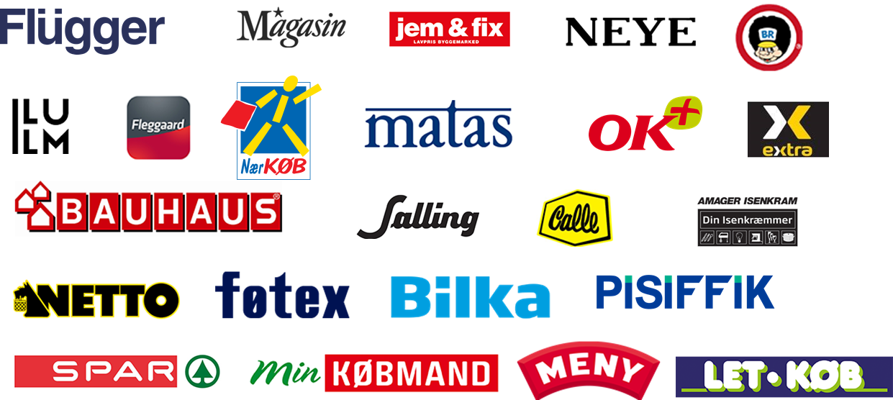



52RETAIL customers

